Slide 1
Module 3
Prompting and Supporting Argumentation:
Focus on Implementation
The formulation of a problem is often more important than its solution, which may be merely a matter of mathematical or experimental skill.
- Albert Einstein

Slide 2
Brainstorm:
PollsEverywhere.com
What classroom norms support a culture of thinking and mathematical argumentation?
Please use your cell phone to respond to the poll:
https://www.polleverywhere.com/free_text_polls/J9jrRHoiLKAfFpV

Slide 3
Animal Populations Task
Original problem from illustrativemathematics.org
Suppose P and Q give the sizes of two different animal populations, where Q > P. In (a) – (d), say which of the expressions is larger. Briefly explain your reasoning in terms of the two populations.
(a) P + Q and 2P
(b) (Q – P)/2 and Q – P/2
(c) and
(d) P + 50t and Q + 50t
Private Think Time
Structured Pairs-Share

Slide 4
Session Objectives
Develop a deeper understanding of argumentation and its potential in the math classroom.
Examine norms and routines that can support mathematical argumentation in the classroom
Develop an understanding of a pedagogy of inquiry to support mathematical argumentation in the classroom

Slide 5
Why watch videos?
Small Slice of Classroom Practice that allows us to focus on student thinking
Allows us to dig deeply into a moment
Productive for helping us think of some students’ interactions.
Focus on Argumentation
Pick the best parts of the lesson to showcase for specific purposes

Slide 6
Set Up Video
Six students are from a Grade 6 class from 2014-2015.
They were all in the same math class and were struggling at the time.
I worked with them in their class to provide support and intervention 3 days a week.
I pulled them once a week to provide instruction focused on math discourse and CCSS-M Mathematical Practice 3.

Slide 7
Tips
Focus on the argumentation
What is the role of argumentation in this classroom?
What purpose does it serve in this lesson?
Focus on the student thinking
How are they making sense of the mathematics?

Slide 8
Guiding Questions for Video
What moves do you see the teacher making to help promote a culture of thinking?
What do you see students saying or doing that relates a culture of thinking?
What norms may have been previously established in this class to support this interaction?

Slide 9
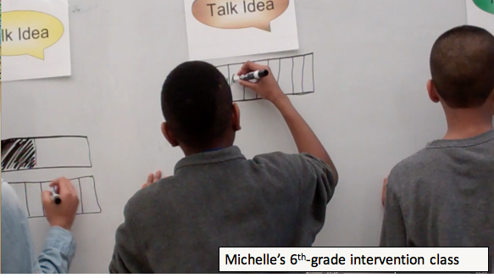
Classroom Norms for Argumentation

Slide 10
Debrief of Video
What moves do you see the teacher making to help promote a culture of thinking?
What do you see students saying or doing that relates a culture of thinking?
What norms may have been previously established in this class to support this interaction?
What questions do you have for Michelle?

Slide 11
Norms/Expectations to Support A Culture of Thinking
There are many different ways to do this in your classroom. You need to consider your particular students
All students can engage in argumentation and need opportunities to!
Handouts in your packet offer some belief and behavioral norm suggestions and resources
Reflect and review materials as we share next steps in developing classroom norms to promote a culture of thinking.

Slide 12
Shifting Gears to
Pedagogical Routines
Definition:
Routine – a sequence of actions regularly followed

Slide 13
Brainstorm: Pedagogical Routines
What routines do you know that help support argumentation and a culture of thinking?

Slide 14
Brainstorm:
Pedagogical Routines
Ideas
Ideas

Slide 15
A Pedagogical Model to Support a Culture of Thinking
New question(s)
Solidify and/or refine new meanings
Generate ideas
Press on and develop ideas collaboratively
Elicit and
Publicize ideas

Slide 16
Problem Solving Tasks Purposes
Provide a common math-teaching-and-learning experience for reflection and discussion
Opportunity to discuss tasks and task implementation
Exposure to/discussion of some teaching strategies
Opportunities to see how others think
To learn more math (connections); engage in productive struggle
For fun! ☺

Slide 17
Let’s Begin...
A pedagogical routine to support a culture of thinking:
Talk Frame Routine

Slide 18
Talk Frame Routine
Think
Individual Think Time
Group Think Time
Talk Idea
Talk Idea
Talk Idea
Sharing some idea with the whole group
We Understand
Summary of the mathematically valid conclusion agreed upon by the class
Exploring Shape Games: Geometry with Imi and Zani, by M. K. Gavin, T. M. Casa, S. H. Chapin, and L. J. Sheffield. Copyright © 2012, by Kendall Hunt Publishing Company

Slide 19
Break Time: 10:20-10:30

Slide 20
Remember our Community Agreements
Judgment Free Zone
Stay focused. Be present and engaged
Be on time and stay on task
Respect others’ opinions/thoughts
Leave your cell phones alone (be present)
Listen Attentively
Stay Positive
Stay engaged
“Vegas” Rule
Encourage risk taking
Be positive
Be respectful of each other
Be positive and encouraging
The “Photo Album” rule

Slide 21
Think

Slide 22
Chain of Flowers
Pattern task
Draw Figure 5. How many tiles does it have?
How many tiles will the 25th figure have? How do you know?
How many tiles are in the nth figure? How do you know?

Slide 23
Sharing Ideas with Whole Group
Talk Idea
Talk Idea
Talk Idea

Slide 24
The Big Math Ideas
There is an strong connection between an exact answer to a problem and a general solution
It is important to label parts of an expression or diagram to show the relationship that they have to each other
Variables, symbols and diagrams can all be used to represent patterns
Multiple approaches may be used to solve a problem
We Understand

Slide 25
Reflecting on the Talk Frame Routine
Think
Thoughts, comments, questions
Consider: What might the Talk Frame, or a similar routine, help you do?
What questions do you have?
Talk Idea
We Understand

Slide 26
How does the Talk Frame Routine SUPPORT the
Pedagogical Model for a Culture of Thinking?
New question(s)
Think
Talk Idea
We Understand
Solidify and/or refine new meanings
Generate ideas
Press on and develop ideas collaboratively
Elicit and
Publicize ideas
Create a TEAM poster.
GOAL: On your poster, show the CONNECTIONS between one component of the Pedagogical Model for a Culture of Thinking and the Talk Frame Routine.
You have 10 minutes to discuss and record.

Slide 27
Talk Frame Routine
Think
Question worded using student accessible phrasing
Talk Idea
Notes representing students’ ideas
(These include correct ideas as well as misconceptions. Also, the number of “talk idea” sections used will vary according to the lesson, student contributions, and teacher’s decisions about how to group ideas. The teacher can also choose to add in a particular “talk idea.”)
We Understand
Summary of the mathematically valid conclusion agreed upon by the class
Exploring Shape Games: Geometry with Imi and Zani, by M. K. Gavin, T. M. Casa, S. H. Chapin, and L. J. Sheffield. Copyright © 2012, by Kendall Hunt Publishing Company

Slide 28
A Pedagogical Model to Support a Culture of Thinking
New question(s)
Solidify and/or refine new meanings
Generate ideas
Press on and develop ideas collaboratively
Elicit and
Publicize ideas

Slide 29
Model & Talk Frame Routine
(Flower Task)
THINK
New question(s)
Flower Task
Draw figure 5.
How many tiles will it have?
How many tiles will the 25th figure have?
How do you know?
How many tiles will the nth figure have?
How do you know?

Slide 30
Model & Talk Frame Routine
(Flower Task)
THINK
New question(s)
Individual work time
Generate ideas
How could the Talk Fame allow students to generate ideas?
How can the teacher facilitate this process?
Partner talk

Slide 31
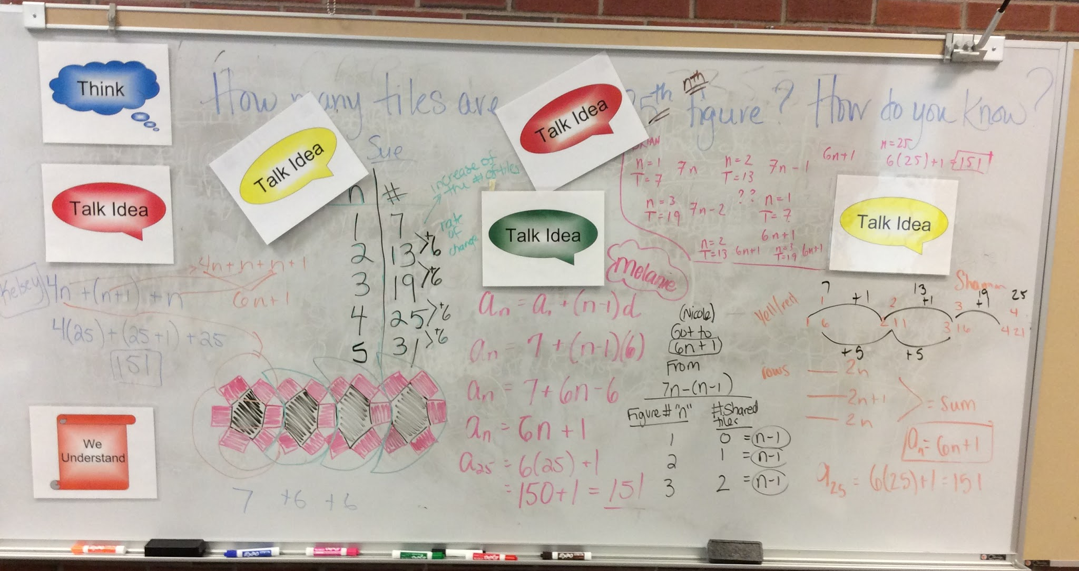
Model & Talk Frame Routine
(Flower Task)
New question(s)
Generate ideas
Talk Idea
Elicit and
Publicize ideas
Talk Idea
How could the teacher facilitate this process in order to promote thinking?

Slide 32
Model & Talk Frame Routine
(Flower Task)
New question(s)
As the class develops ideas, what is the teacher’s goal?
How might that goal be achieved based on student responses?
Generate ideas
Talk Idea
Press on and develop ideas collaboratively
Elicit and
Publicize ideas
Talk Idea

Slide 33
Model & Talk Frame Routine
(Flower Task)
We Understand
New question(s)
What can the teacher do to help students make connections between ideas and to solidify their learning?
Generate ideas
Solidify and/or refine new meanings
Press on and develop ideas collaboratively
Elicit and
Publicize ideas

Slide 34
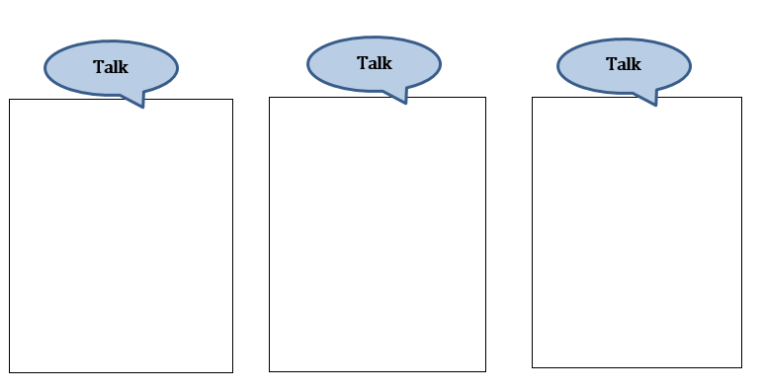
Talk Fame Routine Template

Slide 35
Working Lunch
Please discuss the following questions:
Which norms/routines do you see yourself using at the beginning of the school year? Why?
All students can and should have opportunities to participate in argumentation. How might that work differ from class to class, or across groups of students with different needs?

Slide 36
Reflecting on Norms & Routines/ Lunch
11:55 - 12:25

Slide 37
Bridging to Practice:
Talk Frame Routine Mini Lesson
With your team, select one of these problems
Individually work the problem
With your team, talk about the problem
What’s worth discussing in a mini-lesson related to this problem?
What would make a good “talk frame” question?
Use the Talk Frame Routine template to help you prepare a mini-lesson
Talk with your team about how you will teach this mini-lesson (who will do what, etc.)
Teach the mini-lesson to your assigned team

Slide 38
Groupings for Team Teach
LOCATIONS:
A & B – Room B, front by white board
C & D - Room B, back corner
E & F – Main Room

Slide 39
Remember the Talk Frame Routine
Think
Question worded using student accessible phrasing
Talk Idea
Notes representing students’ ideas
(These include correct ideas as well as misconceptions. Also, the number of “talk idea” sections used will vary according to the lesson, student contributions, and teacher’s decisions about how to group ideas. The teacher can also choose to add in a particular “talk idea.”)
We Understand
Summary of the mathematically valid conclusion agreed upon by the class
Exploring Shape Games: Geometry with Imi and Zani, by M. K. Gavin, T. M. Casa, S. H. Chapin, and L. J. Sheffield. Copyright © 2012, by Kendall Hunt Publishing Company

Slide 40
Acknowledgements
Bridging Math Practices Project is supported by a Math-Science Partnership Continuation Grant from the Connecticut State Department of Education.
Bridging Math Practices was a collaborative project among UConn, Manchester Public Schools, Mansfield Public Schools, and Hartford Public Schools
UConn: Megan Staples (PI), Jillian Cavanna (Project Manager), Fabiana Cardetti (Co-PI)
Lead Teachers: Cathy Mazzotta (Manchester), Michelle McKnight (Manchester), Belinda Perez (Hartford) Teresa Rodriguez (Manchester)

