Slide 1
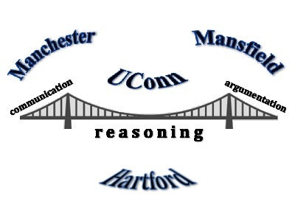
Welcome Back!!
Bridging Practices Among Connecticut Mathematics Educators
Math Science Partnership Grant
Tuesday, February 3, 2015

Slide 2

Where have we been???
When we last left our superheroes…

Slide 3
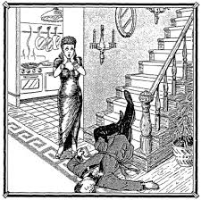
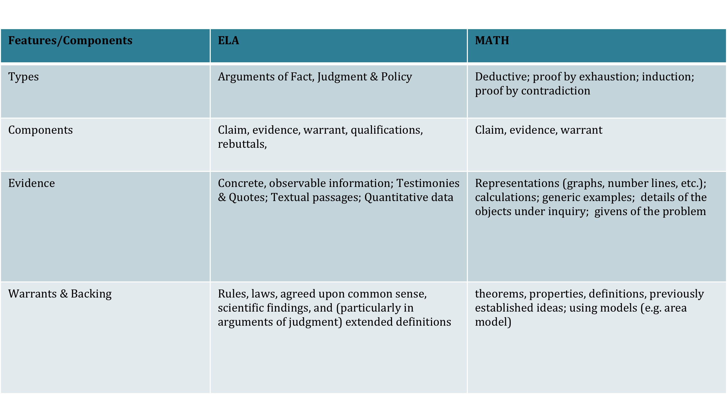



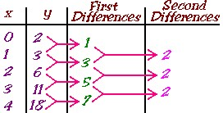

Argumentation in ELA vs Mathematics
SLIP OR TRIP
A Number Trick!
Salary Options!
Reasoning with Tables, Graphs, Equations
Stars
and Stairs
Notes:
Steve – handouts (help from Donalyn): These should go into their folders(chart is in the Monday Memo)

Slide 4
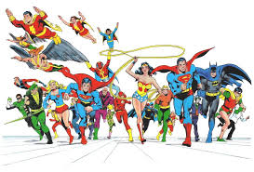
Where are we going???

Slide 5
Today’s Themes
Argumentation as an Everyday Event
  Where’s the argument in a “procedural” or routine questions?
  How do I modify a task to incorporate argumentation?
Supporting students in communicating reasoning -- verbal and written
Continue our work on quality arguments…

Slide 6
Agenda
Math fun! **
Math and Argumentation in Everyday Tasks
  Elementary (stay here in rm 144)
  Secondary (rm 142)
Share out morning work
Working Lunch – looking back and a look ahead
Supporting argumentation through task modification and verbal → written discourse
Work time
Share out from lunch, logistics, exit survey
  ** Coaches have a special mission and will meet in rm 101 with the secret maraca signal
Notes:
Steve: handout with agenda for the day

Slide 7

A Mathematical Argument
It is…
  A sequence of statements and reasons given with the aim of demonstrating that a claim is true or false
  “an argument is a collective series of statements to establish a definite proposition” (Monte Python)
It is not…
  (Solely) an explanation of what you did (steps)
  A recounting of your problem solving process
  Explaining why you personally think it’s true for reasons that are not necessarily mathematical (e.g., popular consensus; external authority, etc. It’s true because Adrianne said it, and she’s always, always right.)

Slide 8
Constructing viable arguments
  use stated assumptions, definitions, and previously established results in constructing arguments.
  make conjectures, including reason inductively about data
  build a logical progression of statements to explore the truth of their conjectures
  analyze situations by breaking them into cases
  recognize and use counterexamples
  justify their conclusions
  communicate them to others
  respond to the arguments of others
  distinguish correct logic or reasoning from that which is flawed
Students at all grades can listen or read the arguments of others, decide whether they make sense, and ask useful questions to clarify or improve the arguments.
Elementary students can construct arguments using concrete referents such as objects, drawings, diagrams, and actions. Such arguments can make sense and be correct, even though they are not generalized or made formal until later grades.
Notes:
Adapted from Pat Callahan – CMP ppt slides
http://teacherthinktank.wikispaces.com/2012+Summer+Institute+Resources
- Or -
http://www.google.com/url?sa=t&rct=j&q=&esrc=s&source=web&cd=2&ved=0CCMQFjAB&url=http%3A%2F%2Fteacherthinktank.wikispaces.com%2Ffile%2Fview%2Fwriting%2Band%2Breasoning%2Bin%2Bmath.pptx&ei=ipSuVIjnKuXasATP1IGIBg&usg=AFQjCNEYHdWPm0gJnFi2G47UC5PP_ieUZA&sig2=J8SJBa4E3RTL8gSXezYzAA&bvm=bv.83134100,d.cWc

Slide 9
An argument …
Claim: the claim is stated clearly
Argument –warrants & evidence
presents a chain of reasoning that links evidence to build to the claim
uses previously established ideas and facts, including definitions, and/or ideas that are established as true within the argument
uses representations (words, symbols, graphs, tables, pictures, etc.) that help convey ideas; the representations used are those the class knows or is able to understand
addresses all cases covered by the claim
Other: Contains no errors in calculations that detract from the argument
Notes:
We will have more specifics later…

Slide 10
A High Quality Argument
Clearly stated Claim
Sufficient/necessary Evidence to support Claim
  uses representations (words, symbols, graphs, tables, pictures, etc.) that help convey ideas; the representations used are those the class knows or is able to understand
Sufficient/necessary Warrants to link Evidence to Claims
  uses previously established ideas and facts, including definitions, theorems, known formulas
Appropriate precision with language and computation
Viable approach to making the argument (form of reasoning)
Notes:
REVISE this one, or think about how we are introducing this. Perhaps with revised version of Maddie’s form…
Give them Smarter Balance work samples and work through criteria chart. Sorting→Use Maddie’s form (revise) to do this
We will not focus on # 5 but can show as an example.

Slide 11
What is “good”?

Slide 12
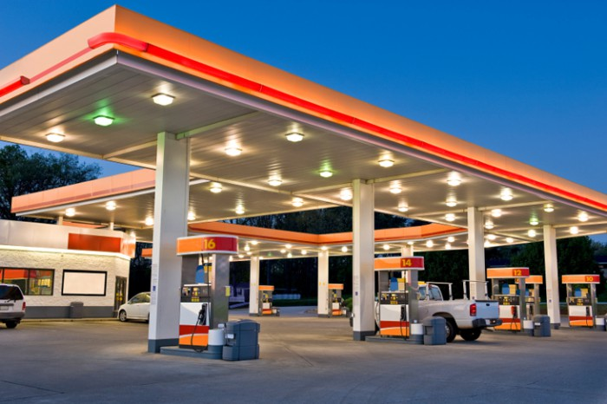


Giving Good Directions
Notes:
Have the dialogue around here?

Slide 13

Audience and Community Matter!

Slide 14

Problem Solving Time!
Coaches – Please head to Room 101

Slide 15


Problem Solving Fun!
From Mathematics Assessment Resource Site (MARS)
map.mathshell.org
Used also for insidemathematics.org
Notes:
Be sure to state purposes

Slide 16
Purposes!
To have fun
To get “in tune” with others- generate shared understanding
  What do I consider high quality? What do they consider high quality? What kinds of things are we each prioritizing? What might I not be considering?
Set up further discussions about the qualities and characteristics of high quality arguments
Potentially - model an exercise you can do with your colleagues

Slide 17
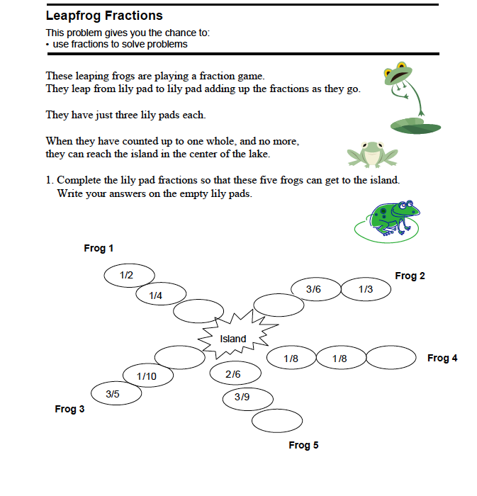
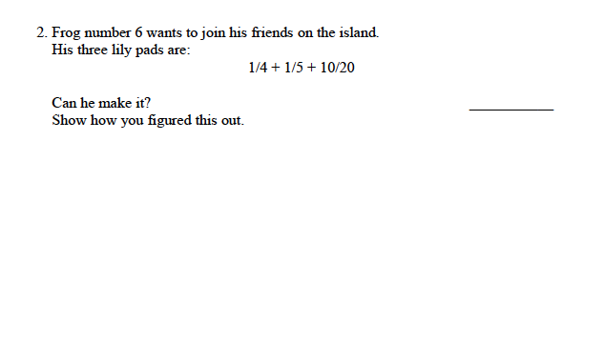
Leapfrog Fractions
… know you are right.
Solve it! (2 frogs from question 1)
Think – Pair – Share
I understand your argument is…
Revise your solution – how could you strengthen it?
Notes:
High, adequate and low quality

Slide 18
Core Ideas of the Task
Equivalent fractions
Combining to a whole
Constructing a viable argument
Notes:
Equivalent – includes comparing
INSERT STANDARDS – if needed
3rd grade standards
3 NF 1 & D NF 3
This doesn’t have anything yet about adding- combining, perhaps because of emphasis on comparing with a whole
Also MP2 and MP7 (structure)
Viewing 4th grade work

Slide 19
LeapFrog Task
Student Work
Work samples are from 4th graders; MARS site
We are asking you to judge the responses as arguments for problem #2 only. “Show how you know.” Did the student show the claim was true?
Roles
The Handler – places work samples in agreed-upon pile
Facilitator – ensures space is made for all to contribute; supports finding consensus
Time Keeper – keeps time and ensures group doesn’t exceed time limits. Can prompt movement to next sample even if full time is not used.
(All– share ideas and keep notes on own set of work samples)
Notes:
*Colored set for handler
*Categories on a Poster

Slide 20
Summarizing Characteristics
Clearly stated Claim
Sufficient/Necessary Evidence to support Claim
Sufficient/Necessary Warrants to link Evidence to Claims
Appropriate precision with language and computation
Viable approach to making the argument (form of reasoning)
Notes:
REVISE this one, or think about how we are introducing this. Perhaps with revised version of Maddie’s form…
Give them Smarter Balance work samples and work through criteria chart. Sorting→Use Maddie’s form (revise) to do this
We will not focus on # 5 but can show as an example.

Slide 21
A few important notes
As you talk about student work samples, try to use the criteria from the grid to describe their work.
  Claims
  Sufficient Evidence
  Sufficient Warrants
  Appropriate precision (language, computations)
  (Viable approach to argument)
Notes:
May not need this one, if previous one is supported with a handout.

Slide 22
As you discuss the quality of the argument, please attend to students’ capacity to
1) construct an argument
and
2) his or her understanding of fractions.
Notes:
Where to put this one??

Slide 23

Agreements
We agree to
Make this a safe place for people to share.
Stay focused on the objective.
Respect each other’s perspective.
Be willing to explain our reasoning.
Allow everyone “think-time”.
We also agree that
Everyone should have a voice.
Everyone should feel safe when given the option to contribute.
People should actively listen to each other, with an open mind.
Finally, we agree that we should …
Enjoy our time here!
Notes:
If time, remind them about our community agreements and add a few from here if not in yet…

Slide 24
Reviewing student work samples

Slide 25


IMPORTANT NOTE!
It is critical to note that ultimately judgment is involved! What counts as “sufficient” evidence and “all necessary” warrants depends on the audience (community, who is judging)
Notes:
Share - Fabiana and journal articles
SmarterBalanced makes a judgment too

Slide 26
AND ANOTHER ONE!
Smarter Balanced has to judge too!
Smarter Balanced seems to be giving “the benefit of the doubt” to some degree – at least at the lower grades. In Cognitive Lab Tests, they found 1/3 of students would have gotten a higher score if all their work had been submitted (and not just what they entered online).
One take away: It’s important to teach beyond the Smarter Balanced scoring guides.
Notes:
Lemons – Field Guide with scoring

Slide 27
Math and Argumentation in Everyday Tasks
  We will split in two groups:
  Elementary (stay here in rm 144)
  Secondary (rm 142)
We will reconvene at 11:45

Slide 28
Whole Group share – 11:45
Elementary, Secondary, Coaches
What have you been you up to?
What did your group work on?
Mention a couple of take-aways
Notes:
Each group (elem, secondary, perhaps coaches) share what they were working on, and a couple take aways.

Slide 29

Working Lunch!
Notes:
What currently counts in your classroom for a valid argument? What qualities or criteria are important to you?
How are these criteria communicated to students?
What kinds of proficiencies did you find at the beginning of the year? Where will growth be?

Slide 30
Working Lunch Overview
Sit at tables with other members from your school or district (see chart) to talk about what you have accomplished so far and where you want to go from here.
Individuals will jot down ideas and then share with the others at your table.
The designated Emailer will type notes and send them to Maddie at the end of the session.
Each team will share one highlight with the entire group at the end of the day.

Slide 31
Working Lunch Roles
Facilitator will move the discussion along so that everyone gets a chance to participate and all questions are addressed within the time allotted.
Electronic Note-Taker and Emailer will take notes as everyone is speaking. S/He will email the notes to Maddie Williams at Madelyn.williams@uconn.edu at the end of the discussion.
Spokesperson will share one highlight with the entire group.

Slide 32
Discussion Questions
What has happened so far in your schools related to the work done in Bridging Math Practices? Brainstorm some of the issues teachers have struggled with related to argumentation. What were some suggestions teachers gave each other?
What are some highlights? Narrow down the brainstorming above to the main (1-2) themes that emerged from the work you’ve done at your school.
What are the goals for your school site for the spring? Think about next steps.
What are some suggestions for the UConn three-day PD on June 24th-26th?

Slide 33
Working Lunch Table Groups
LUNCH ENDS @ 12:55
Table | School | Room
1 | Martin Elementary | 144
2 | Bowers Elementary & Verplanck | 144
3 | Highland Park Elementary | 144
4 | Washington Elementary | 144
5 | Mansfield Elementary Schools | 144
6 | Mansfield Middle School | 144
7 | Bulkeley High School | 144
8 | Bennet Academy | 142
9 | Buckley Elementary | 142
10 | Manchester High School | 142

Slide 34


Verbal
Written
Supporting argumentation as an everyday event
Notes:
Introduce the connection between verbal and written but one does not supersede the other rather it is connecting the two parts

Slide 35

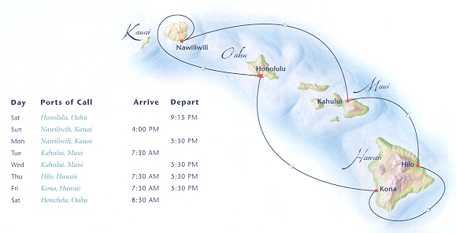



Agenda
Characteristics of Tasks Lending Themselves to Mathematical Argumentation
Phase 1:
Treasure hunt
Phase II: Finding
your own treasure
Notes:
Agenda –
Phase 1: For example we are going on a treasure hunt- you already have these resources what can you find in what is already there; what can be misleading in the resources that you have
Phase 2: Then finding your own treasure

Slide 36
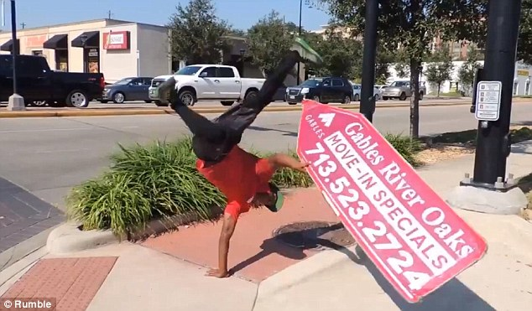



Notes:
Thinking about how this worthwhile – SBAC tests and identifying questions that will prepare students for the assessments
This is what is happening around you and then specific to bridges this is what you are doing – focus on argumentation

Slide 37

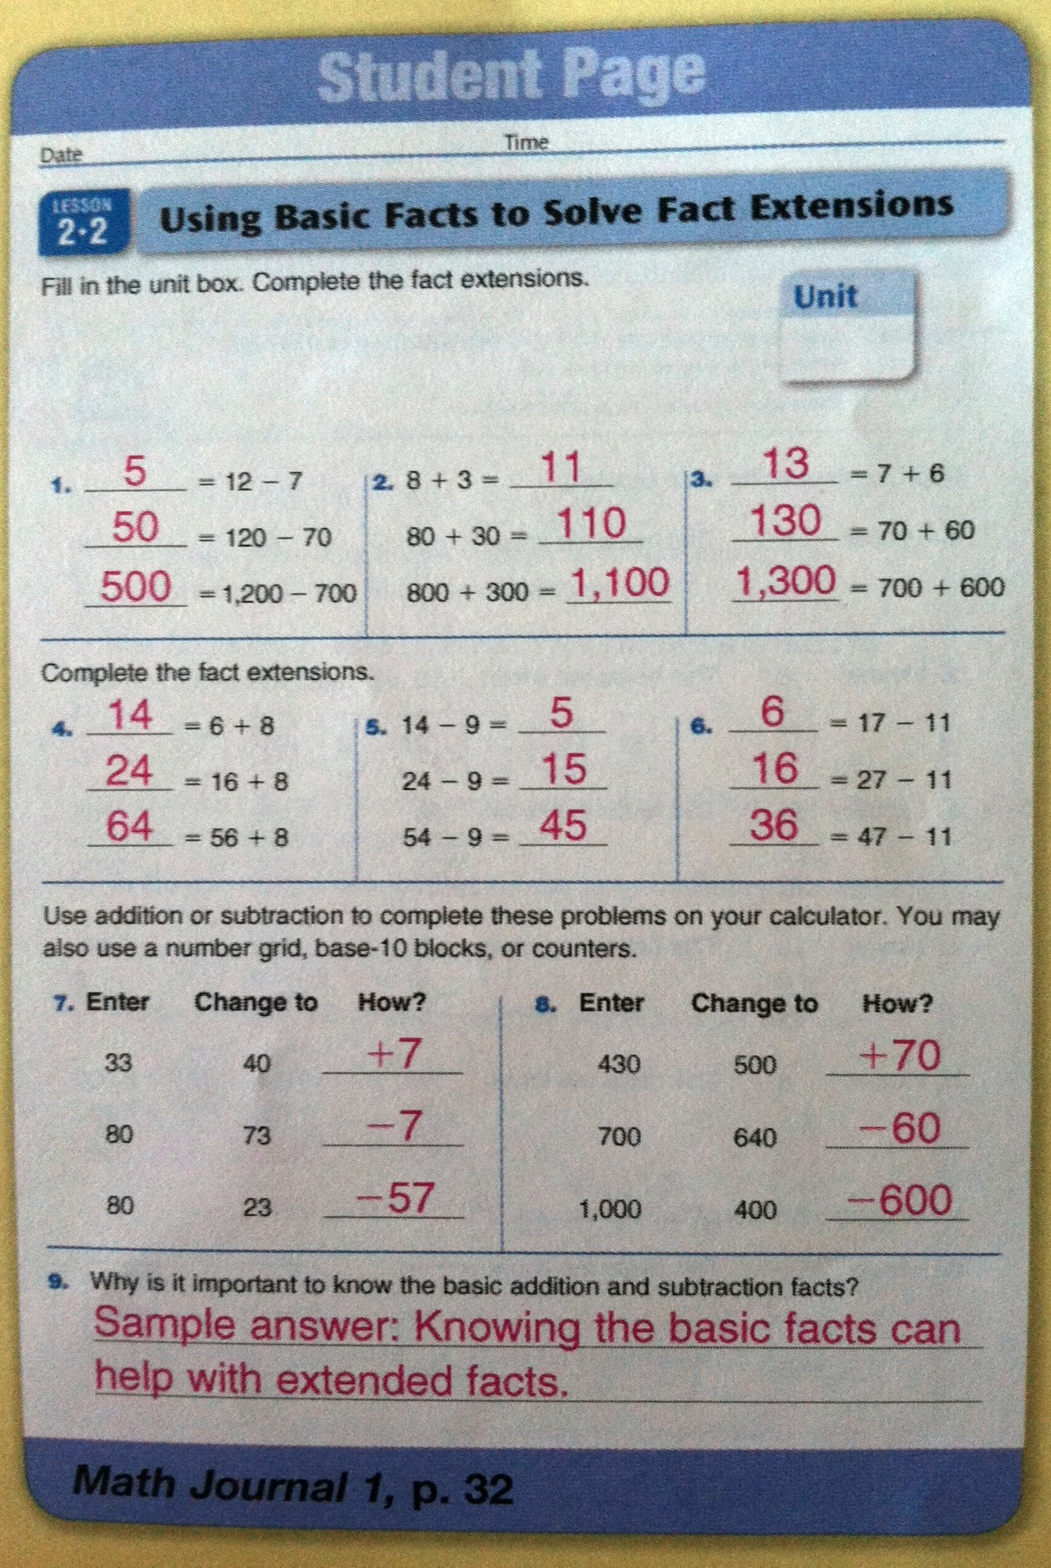
Curriculum as a resource
Notes:
Curriculum is something to use but you need to decide how to use the curriculum to support your students’ needs.

Slide 38
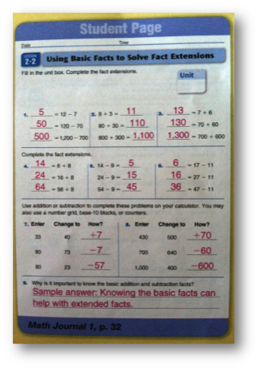

Curriculum as a resource
Why is it important to know the basic addition and subtraction facts?
Notes:
More careful look at the “writing” question. Think about would this be a question you would want your students to write about, is this enough space? What would the purpose of this question be, would there be some other way to gather this information? All things to think about – led us to the writing study.

Slide 39




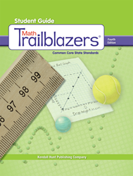

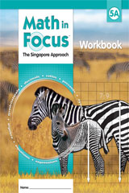
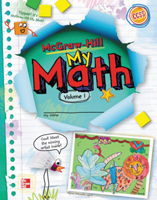
Grade 3 Writing Study
(with argumentation application)
Notes:
Share this with you – we went through a similar process as you are doing so we will share a few recommendations of what we found that might be useful to you and this is not specific to grade 3 – more about process than grade level – talk about our research question but our process of identifying writing prompts and our analysis parallels what you will be going through

Slide 40

Quick Facts About the Study
1,923 prompts analyzed
All comprehensive curriculum resources
Published after 2010
Common Core Editions
Looked at the student resource

Slide 41
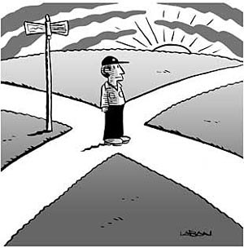


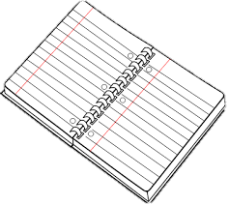

Notes:
Slide with the jungle cross roads and not knowing which one will have the “treasure” underneath – show different icons
Show the different icons – challenge of where to go next

Slide 42
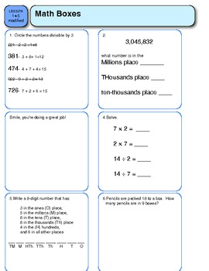
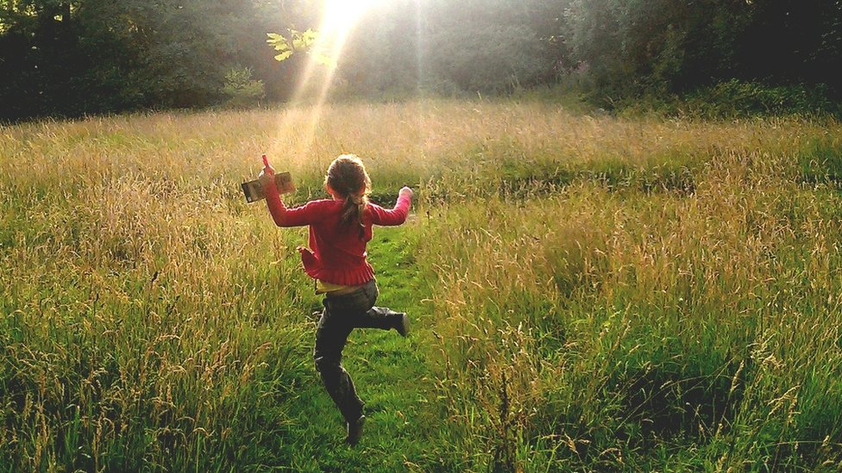
Number of Writing Prompts
Identified a range of questions from 44 to 486 writing prompts in the curriculum resources
  If there are lots of questions, you may ask your students to answer the most essential questions and skip the rest
Notes:
Quick show of hands how often think should write a “substantial” response in math:
Every day
A few times a week
Once a week or more

Slide 43



Writing in Math
Write arguments—key!

Slide 44
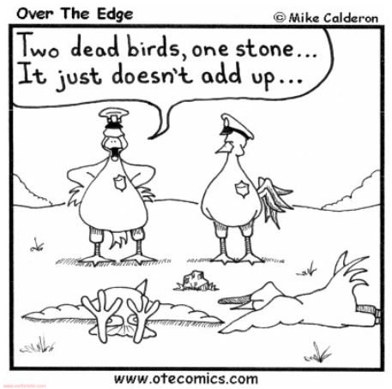
learning to write
writing to learn

Slide 45


Writing Indicators?
Mathematical Discourse
Q: What is the same about the two fractions?
A: The denominators are the same size.
Q: What is different about the two fractions?
A: They are built with a different number of unit fractions or they have a different numerator
Notes:
When looking for the writing there may be indicators (like the icons) but it does not mean that writing is always there
Try to look it might be hidden
Try to look it might be mislabeled
Highlight: Mathematical Discourse (when there are labels that can be deceiving) What is the same about the two fractions? The denominators are the same size. What is different about the two fractions? They are built with a different number of unit fractions or they have a different numerator (put this on slide with a caution sign next to it)
Ask, what do you notice?
***Should we delete this one too???

Slide 46

Not always writing where you think…
1. Does your answer make sense?
2. Show how you figured your answer out.
3. Write your answer. How do you know it is correct?
Notes:
When you find something it might not be what you think it is and it should be
Even though we had this icon we might not actually have the correct label for what the question is
Questions are often mislabeled
Pull in argument piece here – you need to make a choice if you are going to start from using your resource or you can develop them yourself – we are getting to this later but we are going to share about the study to start thinking about what this might look like

Slide 47


Not Always “Writing”
Label
Write a number sentence
Fill in blanks
Show steps to a solution
Copy information
Only draw
Require only a numerical answer
You can answer with one word
Notes:
None of these press students to write an argument

Slide 48

What might be some indicators?
Mathematical practices
SMP 3
Problem solving
Challenge
Extension
Higher Order Thinking Questions
Notes:
What might be some signals and indicators that a question might lend itself to argumentation (have the participants contribute here) but have some of the things listed here to start conversation --- put bridges icon on here
Maybe put a sad face and put a flashing sign that shows here is the argumentation and show we can relate because it is challenging to identify the questions (not looking for specific stems – what are clues in your curriculum resource that leads to the argumentation questions) show building analogy that it is easier to work with something you have to adapt than it is to develop something brand new
Have this list to start the conversation:
Problem Solving
Mathematical Practices
SMP 3
Challenge
Extension
Higher Order Thinking Questions

Slide 49

Amount of Writing Space
How much space should students be given?
  Students will write to fill the space
  Publishers often include white space for visual aesthetic
Notes:
Ask them if they have ever had a student ask “how much do I need to write”?
Does more mean better with an argument? No!

Slide 50
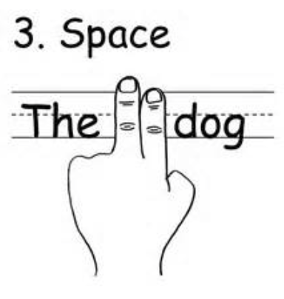
Results
None to ~ a paragraph’s worth

Slide 51
Possible Task Modification
Think about how much you think is appropriate for students to write, and give them an amount of lines that reflect this
  Longer argument is not always a better one, but you need a sufficient amount of space
  Students should not use amount of space as an indicator of a good argument
Notes:
Handout to match this
This could be what you can tell students you are looking for
Hold up your hands to indicate about how much you would expect

Slide 52
Press for the Inclusion of a Specific Writing Feature – Examples
“Explain how to round 458 to the nearest hundred. Include a number line in your explanation.”
“What pattern can you use to multiply a number and 9 if you know 10 times the number? Give an example.”
“Write your own problem that is the same type as problem 1.”

Slide 53
Results
No Writing Feature | Writing Feature Included
92.1% | 7.9%

Slide 54
Possible Task Modification
Add in a writing support specific to argumentation
  “Write a mathematical argument to answer the following question”
  “Write your claim”
  “Include evidence”
  “Consider your warrants”
  “Convince a classmate”
  Add in a frame (e.g., “I think ___ because___)
Notes:
Handout to match this
This could be what you can tell students you are looking for
What else do you think?

Slide 55
Press for a Type for Writing
Write a question
Explain what
Rewrite a sentence
Describe observations
Compose a problem
Define a term
Explain why
Compare and contrast
Notes:
Mix these up and ask them which one or ones might lend themselves to argumentation and then show the results of the study
Include definition of some (explain what/why and describe observations)

Slide 56
Results
Explain What | Explain Why | Describe Observation | Compose Word Problem | Rewrite Sentence
36.2% | 27.3% | 7.5% | 6.4% | 0.4%
Define a Term | Write a Question | Compare/ Contrast | Other | Multiple
4.8% | 3.3% | 5.3% | 7.4% | 1.4%

Slide 57

Relax we have recommendations…
Notes:
Having someone on the deserted island under an umbrella with a drink so relax and we have recommendations

Slide 58
Possible Task Modification
Press students to explain why
  Do not use simply “explain”
  Add: “Explain why”
  Start the prompt with “why”
  Use “explain your thinking”
  Ask,
    “Do you agree? Why?”
    “Do you agree or disagree? Why or why not?”
Press for the inclusion of a specific writing feature
Notes:
For last bullet, ask what feature(s) of a mathematical argument are students pressed to include

Slide 59
Press to Write About Procedures or Concepts (explain what/explain why)
Procedural: The prompt calls for an explanation that can be written in a step-by-step manner to describe rules, strategies, and/or algorithms. The steps might potentially include numeric representations, symbols, and/or words.
Conceptual: The prompt calls for an explanation that can be written by proposing a generalization or principle. Note that although a procedure might be a component of the prompt, students might be asked to conceptually respond to the given procedure (e.g., why there is a “1” above the tens place in the sample addition problem that has been provided).
Notes:
From explain what and explain why some pressed students for a procedural and some pressed for a conceptual question and do you think both one or none might lead them to argumentation

Slide 60

Results
Explain What |  |  | Explain Why
Procedural | Conceptual | Both | Procedural | Conceptual | Both
69.46% | 28.2% | 2.3% | 49.2% | 44.9% | 5.9%

Slide 61

Possible Task Modification
Skip procedural questions and eliminate the repetitive question
  Not: “Solve the problem. Explain.”
  Instead: “How do you know your thinking is correct?”
Push past procedural explanations
  Present a part of a procedure and have students explain why
  “What have you learned in class to defend your reasoning?”
  “How will you use ___ to explain how to solve ___?”
Notes:
Add pix of clock—writing about an explanation of procedures/steps NOT the best use of students’ time.
Also maybe include same skipping icon from before

Slide 62
Press for Writing About Their Own or Others’ Solutions
Only their own solution
Only someone else’s provided solution
Or two or more provided solution
Notes:
Come back to this slide in the second section – think about this as a student and their own solution they are saying what they did and with the second two students are more likely to defend their claim – use explain what and explain why

Slide 63
Possible Task Modification
Present one possible solution
  “A student thinks ___. Do agree or disagree? Why?”
  Make sure the student sometimes is right, sometimes is wrong
Notes:
*** Make these – possible task modification --- slides distinct so that they recognize that these are for them and they stand out from the other slides

Slide 64
Possible Task Modification
Present two possible solutions
  “Student A thinks this. Student B thinks that. Who do you agree with? Why?”
  Make sure Student A sometimes is wrong, sometimes is right
  Make sure Student B sometimes is wrong, sometimes is right
  Make sure Students A and B sometimes are both right
  Make sure Students A and B sometimes are both wrong
Notes:
*** Make these – possible task modification --- slides distinct so that they recognize that these are for them and they stand out from the other slides

Slide 65
Verbal
Written
Supporting argumentation as an everyday event
Notes:
All tasks can be used with verbal or written discourse
Verbal first BEFORE they write

Slide 66
Prompts just press
Teachers make it happen!
“Make explicit ‘not even in the ballpark’ standards—and stick to them!”
Hand papers back if they do not include what you ask of them
(Tom Deans, University Writing Center, “Responding to Student Writing”)

Slide 67

Inquiry Project Collaboration
Introduction
Ch. 2: Talk Frame
Ch. 3: Modeling
Ch. 4: Peer Review
Ch. 5: Shared Writing Frame
Ch. 6: Argument Writing Frame (AWF)
Ch. 7: Restructured AWF
Ch. 8: Trends Across Groups
Notes:
Will be using task modification 6 or 7

Slide 68

Next Steps
Use now if you have time
Use in next session
Use with PLC
Use on your own
Work with colleagues, interns

Slide 69



Work Time!
Please reconvene at __2:40 _
(2:35 – tRansition to sharing out)__

Slide 70
Reflect and Share from Worktime
Please record your “next steps” for your current work.
Which task do you plan to implement this spring (where you also collect student work samples, and submit to repository)?
Share with neighbor

Slide 71


Slide 72
Sharing from Lunch Discussions

Slide 73
Logistics and Final Thoughts
Summer dates – June 24 - 26
Culminating Event – TBD

Slide 74


Prizes!!!
THANK YOU!!!!

Slide 75
Exit Slip
Exit Slip/ Reflection – survey from evaluator
  Do online if you like, or hardcopy
  http://tinyurl.com/Feb3Survey
  https://www.surveymonkey.com/s/P8NN6FW

Slide 76
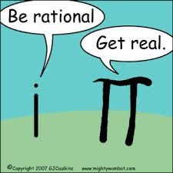
THANK YOU!!!!!
See you at your schools!!!

